Slide 1

Introduction to Accounting
Dr. R.Nalini
Faculty Member, School of Management
SASTRA Deemed To Be University
Thanjavur – 613 401
nalini@mba.sastra.edu

Slide 2
Unit 1 – Introduction to Accounting

Slide 3
Introduction
Every human being wants to lead its life. To lead life, the human beings are supposed to undertake an occupation. Human beings are continuously engaged in some activity or other in order to satisfy their unlimited wants. These occupations are called human occupations.
Classification of human occupations:
Employment
Profession
Business

Slide 4

Employment
Under employment, one person has to work under another person called as an employer. The person who works for the employer is called as an employee and he works for a remuneration called wages if it is daily paid and salary it is monthly paid. The employee has to adhere to the standing instructions of the employer which is termed as terms of employment. The relationship between the two persons is employer-employee relationship.

Slide 5

Profession
A person is called as professional if he has acquired professional knowledge i.e., the expertise or know-how he has obtained due to his continuous and repeated practice. The relationship between these two persons is that of professional man and a client. If a person independently practices, he is called as professional man and if he is employed in any organization for a fixed remuneration, he is called as an employee.

Slide 6

Business
Business comprises of industry and commerce. Industry deals with production of goods and services and commerce deals with the exchange of goods and services.
Types of industries:
Manufacturing industries are engaged in transforming raw material into finished product with the help of machines and manpower. The finished goods can be either consumer goods or producer goods eg., textiles, chemicals, sugar industry, paper industry and the like.
Extractive industries deal with the extraction of natural resources beneath the earth. For example, extractive industries deal with iron ore, coal ore, quarries and the like.

Slide 7
Business
Genetic or primary industries deal with the reproduction of animals and plants. For example, genetic industries deal with agriculture, cattle breeding, fisheries, animal husbandry, plant nurseries and the like.
Processing industries deal with the production of products with different processes. It processes bulk resources into other products. It includes petrochemicals, textiles, food, beverages and the like.

Slide 8
Business
Construction industries involve in the construction of buildings, bridges, dams, roads and the like.
Service industries include education, tourism, hotel, transport, medical, legal, banking, insurance, entertainment and the like.
Assembling industries involve in assembling of a product with various parts or components. It includes car, television, computers, mobile, bus and lorry manufacturing.

Slide 9
Characteristics of business
1. Dealing in goods and services: Business deals with the exchange of goods and services produced by industries. The exchange of goods and services is called a transaction. The business should consist of repeated and continuous transactions. A single transaction does not constitute business.
2. Profit motive: Any transaction carried with a profit motive is called a business transaction. Profit will be determined as a percentage on cost to cover all operating expenses and finally a smaller proportion will be taken by the owner of the enterprise.
3. Risk factor: Every business should undergo the element of risk in exchange of goods and services.

Slide 10

Definition of accounting
Accounting is an information system that provides accounting information to the users for decision-making. It is the language through which it speaks about the financial condition of the business to insiders and outsiders, namely stakeholders.
The American Institute of Certified Public Accountants defines accounting as ‘‘Accounting is the art of recording, classifying and summarizing in a significant manner and in terms of money, transactions and events which are, in part at least, of financial character, and interpreting the results thereof.’’

Slide 11
Meaning of accounting
Recording: It is concerned with the recording of financial transactions in an orderly manner, soon after their occurrence in the proper books of accounts.
Classifying: It is concerned with the systematic analysis of the recorded data to accumulate the transactions of similar type at one place.
Summarizing: It is concerned with the preparation and presentation of the classified data in a manner useful to the users.
Interpreting: The accountants should interpret the statements in a manner useful to action. The accountant should explain not only what has happened but also (a) why it happened, and (b) what is likely to happen under specified conditions.

Slide 12
Objectives of Accounting
To provide useful information to various interested parties.
To maintain systematic and complete records of business transactions
To protect business properties
To facilitate rational decision making
To calculate profit and loss
To ascertain the financial position of the business.

Slide 13

Definition of Bookkeeping
The process of complete and systematic record keeping of the monetary transactions of an organization by the bookkeeper is known as bookkeeping.
The purpose of bookkeeping is to disclose the correct picture of income and expenditure at the end of the accounting period.
The work of the accountant begins where the work of bookkeeper ends.
There are two methods of Bookkeeping:
Single Entry system of Bookkeeping
Double Entry system of Bookkeeping

Slide 14
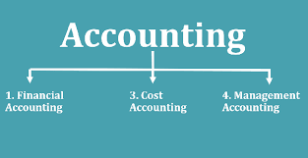
Branches of accounting
1. Financial accounting:
The object is to ascertain the results (profit or loss) of business operations during the particular period and to state the financial position (balance sheet) as on a date at the end of the period.
2. Cost accounting:
The object is to find out the cost of goods produced, or services rendered by a business. It also helps the business in controlling the costs by indicating avoidable losses and wastes.
3. Management accounting:
The object is to supply relevant information at appropriate time to the management to enable it to take decisions and effect control.

Slide 15
Users of accounting information
External Users of Accounting Information:
Investors:
Investors are interested in knowing the financial health of the organisation and safety of their investment.
Creditors:
To know the liquid position, they need accounting information relating to current assets, quick assets and current liabilities which is available in the financial statements.

Slide 16
External Users of Accounting Information
Members of Non-profit Organisations:
They need accounting information to know how their contributed funds are being utilised and to ascertain if the organisation deserves continued support or not.
Government:
Central and State Governments are interested in the accounting information because they want to know earnings or sales for a particular period for purposes of taxation.

Slide 17
External Users of Accounting Information
Consumers:
Consumers need accounting information for establishing good accounting control so that cost of production may be reduced with the resultant reduction of the prices of goods they buy.
Research Scholars:
Accounting information, being a mirror of the financial performance of a business organisation, is of immense value to the research scholars who wants to make a study to the financial operations of a particular firm.

Slide 18
Internal users of accounting information
Internal users of accounting information are those persons or groups which are within the organisation.
Owners:
They need accounting information to know the profitability and the financial position of the concern in which they have invested their funds.

Slide 19
Internal users of accounting information
Management:
Accounting information is an aid in this respect because it helps a manager in appraising the performance of the subordinates. The important functions of management like planning and controlling can be carried with the accounting information. Accounting information is also helpful to the management in fixing reasonable selling prices for its products.
Employees:
Employees are interested in the financial position of a concern they serve particularly when payment of bonus depends upon the size of the profits earned.

Slide 20
Systems of accounting
Cash System:
Under this system, actual cash receipts and actual cash payments are recorded. Credit transactions are not recorded at all until the cash is actually received or paid. This system does not make a complete record of financial transactions of a trading period as it does not record outstanding transactions like outstanding expenses and outstanding incomes.

Slide 21
Systems of accounting
Mercantile (Accrual) system:
Under this system all transactions relating to a period are recorded in the books of account i.e., in addition to actual receipts and payments of cash income receivable and expenses payable are also recorded. This system gives a complete picture of the financial transactions of the business as it makes a record of all transactions relating to a period.

Slide 22
Advantages of financial accounting
Replacing memory: Accounting records all transactions in books of record and hence, it is not important that the businessman should memorize all the transactions.
Assisting the performance of the business: Based on these records, Income Statement is prepared to know the profit earned and the loss incurred by the concerned business.

Slide 23
Advantages of financial accounting
Assessing the financial status of the business: The statement is made at the end of the accounting year and reveals the true position of the business on a particular date.
Documentary evidence: Accounting records can be utilized as proof in the court for the claim of the business.

Slide 24
Advantages of financial accounting
Assisting in realisation of debt: The personal account shows the exact amount due to the debtors.
Facilitating the sale of the business: The financial statement of the business reveals the value of assets and liabilities of the business.

Slide 25
Advantages of financial accounting
Preventing and detecting frauds: Systematic and orderly accounting prevents employees from committing fraud.
Helpful to management: It empowers the management to assess the achievements of its performance.

Slide 26
Disadvantages of financial accounting
Ignores qualitative aspects of transactions: Business Transactions which are of monetary nature only find a place in accounting. It ignores qualitative elements like management reputation, employee morale, labour strike etc.
Biased accounting information: Accounting results are based on the information provided to it. The management may be biased and feed manipulative data to confirm its point of view.

Slide 27
Disadvantages of financial accounting
Ignorance about the present value of business: The value of assets in the balance sheet is shown at its book value and not at the market value.
Inexactness: Accounting evaluates profit or loss of the business on the basis of the real and planned estimates. Accountants make the valuation of the stock, determine the method of depreciation and maintain various provisions under different methods.

Slide 28
Characteristics of Accounting Principle
Uniform set of rules or guidelines developed to ensure uniformity and easy understanding of the accounting information.
Human made therefore derived from experience and reason.
Not static and is bound to change with the passage of time and business practices.
Depends upon the fulfillment of the following criteria a) Relevance b) Objectivity c) Feasibility

Slide 29
Categories of Accounting Principles
Accounting concepts Accounting convention

Slide 30
Accounting Concepts
This concept provides the foundation for accounting process and enables the user to understand the financial statement of the enterprise in a better way. May be considered as postulates i.e basic assumptions or conditions upon which the science of accounting is based.

Slide 31

Accounting Concepts
Business entity: Business is assumed to have distinct entity and separated from the existence of proprietor and other business units. As an accountant, business transaction should be recorded from firm point of view and never from the viewpoint of proprietors.

Slide 32

Accounting Concepts
Money measurement concept: Money is the only practical unit of measurement that can be employed to achieve homogeneity of financial data. In accounting, only business transaction which is financial in nature are identified and recorded.

Slide 33

Accounting Concepts
Going concern concept: It is assumed that business unit has a reasonable expectation of continuing business at a profit for an indefinite period of time. A business unit is deemed to be going concern and not a gone concern. It will continue to operate in future.

Slide 34
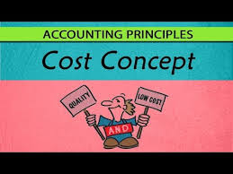
Accounting Concepts
Cost Concept: A fundamental concept of accounting closely related to the going concern concept is that asset is recorded in the books at the price paid to acquire it and that this cost is the basis for all subsequent accounting for the assets.

Slide 35
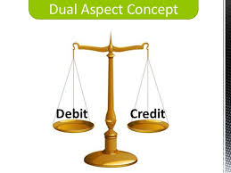
Accounting Concepts
Dual Aspect of accounting: According to this concept every financial transaction involves a two-fold aspect
(a) yielding of benefits
(b) the giving of benefits.

Slide 36
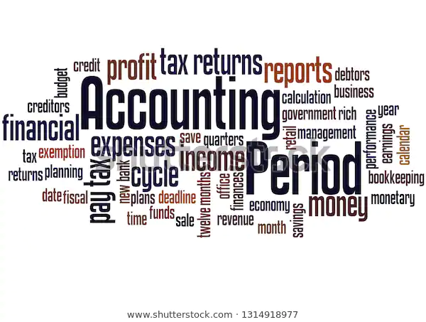
Accounting Concepts
Accounting period Concept: Business as a going entity will continue indefinitely and one has to wait for a very long period to estimate the financial result of business. So, the accounts are closed for a period of twelve months to know the profit earned or loss suffered during the period. Income Tax Act 1961 specifies the financial year (from April to March) as the accounting period.

Slide 37
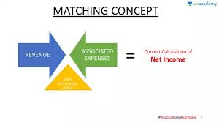
Accounting Concepts
Matching Concept: The matching concept is an accounting practice whereby expenses are recognized in the same accounting period as the related revenues are recognized.

Slide 38
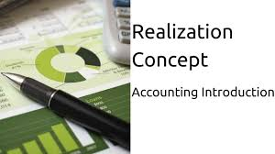
Accounting Concepts
Realisation concept: According to this concept revenue is only realized when the goods or service related to service is delivered or rendered.
The significance of the Realisation Concept includes:
This concept helps make accounting information more objective.
It ensures that transactions are recorded only when goods are delivered to the buyer, ensuring accurate revenue recognition.

Slide 39

Accounting Concepts
Accrual Concept: according to this concept expense and revenue is recorded when they occur whether cash paid or not.
The Accrual Concept, also known as the Periodicity Concept and Mercantile Accounting System, is a fundamental principle in accounting.
For example, if M/s XYZ & Co sells goods worth ₹75,000 on March 20, 2024, and receives the payment on April 15, 2024, the amount is considered due and payable on the sale date, March 20, 2024. Thus, it must be included in the revenue for the fiscal year ending March 31, 2024.

Slide 40
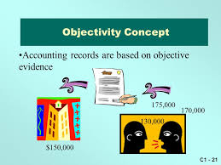
Accounting Concepts
Objective Evidence Concept: This concept ensures that all accounting must be based on objective evidence ie. every transaction recorded in the books of accounts must have a verifiable document in support of its existence.

Slide 41
Accounting Conventions
A convention may undergo a change with the time to bring about change in the quality of accounting information. They also denote the circumstances which guide the accountants while preparing the accounting statement.

Slide 42
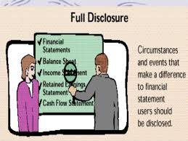
Accounting Conventions
Convention of Full disclosure:
All significant information relating to the economic affair of the enterprise should be completely disclosed such as proprietor present and potential creditors, investors and other. The convention of disclosure also applies to events occurring after the balance sheet date and the date on which the financial statement are authorized for issue.

Slide 43
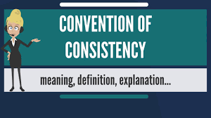
Accounting Conventions
Convention of consistency:
According to this convention, the accounting practices should remain unchanged from one period to another. It requires that working rules once chosen should not be changed arbitrarily and without notice of the effect of the change to those who use the accounts.

Slide 44

Accounting Conventions
Convention of Conservatism
According to this convention, all anticipated losses should be recorded in the books of accounts but all anticipated or unrealised gains should be ignored.
Convention of Materiality
Items having insignificant effects or being irrelevant to the user need not be disclosed. These unimportant items are either left out or merged with other items.

Slide 45
Basic accounting terminologies
Transaction: An economic activity that affects financial position of the business and can be measured in terms of money e.g. sale of goods, paying for expenses etc.
Voucher: The documentary evidence in support of a transaction is known as voucher.

Slide 46
Basic accounting terminologies
Capital: Amount invested by the owner in the firm is known as capital. It may be brought in the form of cash or assets by the owner.
Drawings: It is the money and/ or goods withdrawn by the owner from the business for personal use.

Slide 47
Basic accounting terminologies
Goods: The products in which the business deal in. The items that are purchased for the purpose of resale not for use in the business are called goods.
Purchases: The term Purchases is used only for the goods procured by a business for resale. In case of trading concerns it is purchase of final goods and in manufacturing concern this is purchase of raw materials. Purchases may be cash purchases or credit purchases.
Sales: Sales are total revenues from goods sold or services provided to customers. Sales may be cash sales or credit sales.

Slide 48
Basic accounting terminologies
Stock in trade: Goods which are kept in business for sale and it is valued at cost price or market price whichever is less.
Closing Stock: It is the value of the goods lying unsold at the end of accounting year. Closing stock of one year becomes the opening stock of next year.
Cost of goods sold: The direct expenses related to producing the goods sold by a business. [COGS = Sales-Gross profit (or) Opening stock+ purchases-closing stock)

Slide 49
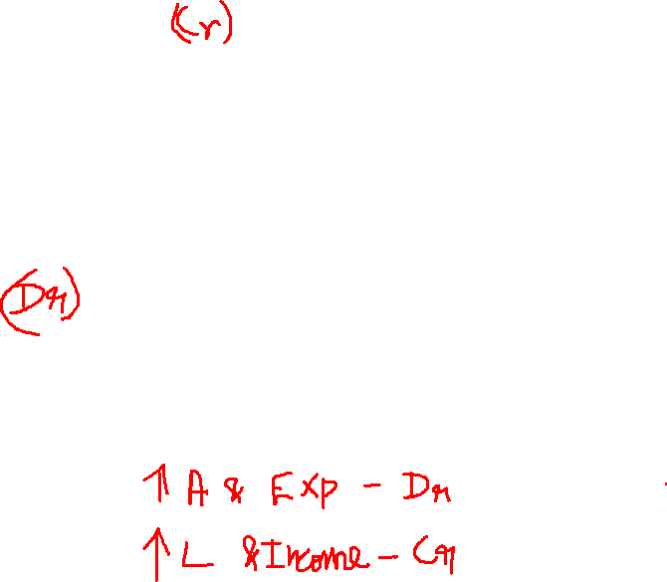
Basic accounting terminologies
Credit: An accounting entry that may either decrease assets or increase liabilities and equity on the company's balance sheet, depending on the transaction. When using the double-entry accounting method there will be two recorded entries for every transaction: A credit and a debit.
Debit: An accounting entry where there is either an increase in assets or a decrease in liabilities on a company's balance sheet.

Slide 50
Basic accounting terminologies
Journal: It is a book of prime entry where business transactions are entered in a chronological order i.e., their order of appearance.
Posting: It is the transfer of entries from journal to ledger.
Ledger: It is a book where the accounts are organized by their nature.
Subsidiary books: The journal is subdivided into various subsidiary journals for recording transactions of similar nature in a chronological order.

Slide 51
Basic accounting terminologies
Assets: Assets are economic resources of an enterprise useful in its operations. Assets can be broadly classified into two types :
Fixed Assets are assets used for normal operations and held on a long-term basis, such as land, buildings, machinery, plant, furniture and fixtures etc.
Current Assets are assets held for a short-term and converted into cash within one year such as debtors, stock etc.

Slide 52
Basic accounting terminologies
Liabilities: Liabilities are obligations or debts that an enterprise has to pay at some time in the future. Liabilities can be classified as :
Long-term liabilities are those that are usually payable after a period of one year e.g. a long term loan from a financial institution.
Short-term liabilities are obligations that are payable within a period of one year, for example, creditors, bills payable, bank overdraft etc.

Slide 53
Basic accounting terminologies
Revenues: Revenue means the income from any source. It should be of regular nature. For example sales of goods/providing services to customer, commission, interest, dividends etc.
Expenses: Costs incurred by a business for earning revenue are known as expenses. For example rent, wages, salaries, interest etc.

Slide 54
Basic accounting terminologies
Expenditure: Spending money or incurring a liability for acquiring assets, goods or services is called expenditure. The expenditure is classified as
Revenue expenditure: If the benefit of expenditure is received within a year it is called revenue expenditure e.g. rent, interest etc.
Capital expenditure: If any expenditure lasts for more than a year, it is treated capital expenditure such as purchase of machinery, furniture etc.
Deferred Revenue Expenditure: It is an expenditure which is revenue in nature and incurred during current year, whereas its benefits are derived in future accounting periods.

Slide 55
Basic accounting terminologies
Expenses (fixed, variable, accrued, operation):
Fixed expenses: payments like rent that will happen in a regularly scheduled period.
Variable expenses: expenses, like labour costs, that may change in a given time period.
Accrued expense: an incurred expense that hasn’t been paid yet.
Operation expenses: business expenditures not directly associated with the production of goods or services—for example, advertising costs, property taxes or insurance expenditures.

Slide 56
Basic accounting terminologies
Accrued Expense: An expense that has occurred but is not recognized in the accounts. It is a liability.
Prepaid Expense: Cost incurred to acquire economically useful goods or services that are expected to be consumed in the revenue-earning process within the operating cycle. It is shown as an asset.

Slide 57
Basic accounting terminologies
Accrued Income: An income that has occurred but is not recognized in the accounts. It is an asset.
Income received in advance (Unearned revenue): An income received in the current accounting year and relates to the forthcoming accounting periods. It is received but not earned in the year of receipt. It is a liability.

Slide 58
Basic accounting terminologies
Bank Reconciliation: A process by which an accountant determines whether and why there is a difference between the balance shown on the bank statement and the balance of the cash account in the firm’s general ledger.
Contingent Liability: Potential liability arising from a past transaction or a subsequent event.

Slide 59
Basic accounting terminologies
Depreciation: Expense allowance made for wear and tear on an asset over its estimated useful life.
Goodwill: Premium paid in the acquisition of an entity over the fair value of its identifiable tangible and intangible assets less liabilities assumed.

Slide 60
Basic accounting terminologies
Operating Cycle: Period between the acquisition of goods and services involved in the manufacturing process and the final cash realization resulting from sales and subsequent collections.
Profit: The excess of revenues over its related expenses during an accounting year is profit. Profit = Revenue- Expenses.

Slide 61
Basic accounting terminologies
Gain: A non-recurring profit from events or transactions incidental to business such as sale of fixed assets, appreciation in the value of an asset etc.
Loss: The excess of expenses of a period over its related revenues its termed as loss. e.g., cash or goods lost by theft of fire etc.
Loss = Expenses – Revenue.

Slide 62
Basic accounting terminologies
Discount: Discount is the rebate given by the seller to the buyer. It can be classified as :
Trade discount: The purpose of this discount is to persuade the buyer to buy more goods. It is offered at an agreed percentage of list prices at the time of selling goods. This discount is not recorded in the account books as it is deducted in the invoice/cash memo.
Cash discount: The objective of providing cash discount is to encourage the debtors to pay the dues promptly. This discount is recorded in the account books.

Slide 63
Basic accounting terminologies
Debtors: Debtors are persons and/ or other entities to whom business has sold goods and services on credit and amount has not received yet. These are assets of the business.
Creditors: If the business buys goods/ services on credit and amount is still to be paid to the persons and/ or other entities, these are called creditors. These are liabilities for the business.

Slide 64
Basic accounting terminologies
Accounts receivable (Bills Receivable): The amount of money owed by customers or clients to a business after goods or services have been delivered and/or used.
Accounts payable (Bills Payable): The amount of money a company owes to its creditors (suppliers, etc.) in return for goods and/or services they have delivered.

Slide 65
Basic accounting terminologies
Trial balance: A business document in which all ledgers are compiled into debit and credit columns in order to ensure a company’s bookkeeping system is mathematically correct.
Income Statement: Summary of the effect of revenues and expenses over a period of time.

Slide 66
Basic accounting terminologies
Balance sheet: A financial report that summarizes a company's assets (what it owns), liabilities (what it owes) and owner or shareholder equity at a given time.
Cash flow: The revenue or expense expected to be generated through business activities (sales, manufacturing, etc.) over a period of time.

Slide 67
Basic accounting terminologies
Certified public accountant: A designation given to an accountant who has passed a standardized CA exam.
Generally accepted accounting principles (GAAP): A set of rules and guidelines developed by the accounting industry for companies to follow when reporting financial data.

Slide 68
Basic accounting terminologies
Gross Margin: The difference between net sales and cost of goods sold.
Net Income/ Net Loss: Excess or deficit of total revenues and gains compared with total expenses and losses for an accounting period.

Slide 69
Basic accounting terminologies
Equity and owner's equity: In the most general sense, equity is assets minus liabilities. An owner’s equity is typically explained in terms of the percentage of stock a person has ownership interest in the company. The owners of the stock are known as shareholders.

Slide 70
Basic accounting terminologies
Expansion: The process of increasing production/sales without varying the main production process or the type of products produced.
Diversification: The process of allocating or spreading capital investments into varied assets to avoid over-exposure to risk.
Insolvency: A state where an individual or organization can no longer meet financial obligations with lender(s) when their debts come due.

Slide 71
Kinds of accounts
There are three kinds of accounts kept by a business firm. They are personal accounts, real accounts and nominal accounts.
Personal accounts:
Natural personal accounts: This type of personal accounts includes all human beings. E.g. Ram’s A/C, Mohan’s A/C, etc.
Artificial personal accounts: Personal accounts which are created artificially by law, such as corporate bodies and institutions, are called artificial personal accounts. E.g. Joint stock companies, clubs, societies, etc.
Representative personal accounts: Accounts which represent a certain person or a group directly or indirectly. E.g. Wages are paid in advance to an employee – a wage prepaid account will be opened in the books of accounts. This wages prepaid account is a representative personal account indirectly linked to the person.

Slide 72
Kinds of accounts
Real accounts:
All assets of a firm, which are tangible or intangible, fall under the category “Real Accounts“.
Tangible real accounts are related to things that can be touched and felt physically. Few examples of tangible real accounts are building, machinery, stock, land, etc.
Intangible real accounts are related to things that can’t be touched and felt physically. Few examples of such real accounts are goodwill, patents, trademarks, etc.

Slide 73
Kinds of accounts
Nominal accounts:
Accounts which are related to expenses, losses, incomes or gains are called Nominal accounts. The dictionary meaning of the word “nominal” is “existing in name only” and the meaning remains absolutely true in accounting sense too, because nominal accounts do not really exist in physical form, but behind every nominal account money is involved. E.g. Salary A/C, Rent A/C, Commission received A/C, etc. The final result of all nominal accounts is either profit or loss which is then transferred to the capital account

Slide 74
Steps in accounting cycle
i. Identify business events, analyze these transactions and record them in journal
ii. Post journal entries to applicable T-accounts or ledger accounts
iii. Prepare an unadjusted trial balance from the general ledger
iv. Analyze the trial balance and make end of period adjusting entries
v. Post adjusting journal entries and prepare the adjusted trial balance
vi. Use the adjusted trial balance to prepare financial statements
vii. Close all temporary income statement accounts with closing entries
viii. Prepare the post closing trial balance for the next accounting period
Prepare reversing entries to cancel temporary adjusting entries if applicable

Slide 75
Golden rules for Double entry
Personal Accounts
Debit the Receiver
Credit the Giver
Real Accounts
Debit what comes in
Credit what goes out
Nominal Accounts
Debit all expenses and losses
Credit all incomes and gains

Slide 76
REFERENCES
https://keydifferences.com/difference-between-bookkeeping-and-accounting.html (Accessed on 23-10-18)
http://www.ddegjust.ac.in/studymaterial/mba/cp-104.pdf (Accessed on 23-10-18)
http://www.accountstudy.com/advantages-limitations-accounting/ (Accessed on 23-10-18)
http://thevistaacademy.com/define-accounting-principles-concepts-and-conventions/ (Accessed on 23-10-18)
https://www.nysscpa.org/professional-resources/accounting-terminology-guide#sthash.cOz0LwSI.dpbs (Accessed on 23-10-18)
http://ncert.nic.in/ncerts/l/keac101.pdf(Accessed on 23-10-18)
https://www.rasmussen.edu/degrees/business/blog/basic-accounting-terms-acronyms-and-abbreviations-students-should/ (Accessed on 23-10-18)
https://www.myaccountingcourse.com/accounting-cycle (Accessed on 23-10-18)
https://www.accountingcapital.com/books-and-accounts/three-type-of-accounts-in-accounting/(Accessed on 23-10-18)

